Slide 1
Psychological Disorders
Chapter 14

Slide 2
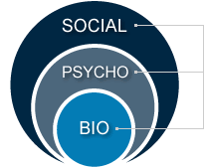
Psychological Disorders
Mental health hotline pre-test http://youtu.be/QXx-n6T7tZg
Psychopathology
  Biopsychosocial Model
    Cognitive, emotional, and behavioral maladaptiveness
Normality versus abnormality?
  David Thompson (http://youtu.be/zA1hyqA6UTY)
The “Bible” of psychopathology
  Diagnostic and Statistical Manual of Mental Disorders (DSM)
  Major DSM Categories
  Table 14.2, page 481
    Questions for me?

Slide 3

Psychological Disorders
Psychological Charades
  Groups acting personality disorders (Table 14.7 page 503)

Slide 4
Psychological Disorders
Psychotic Disorders
  Delusions
    Beliefs
  Hallucinations
    Sensations and perceptions
  Schizophrenia
    Case study (http://youtu.be/aBKSOxqu7CQ)
      1. What is it not?
      2. What is the role of nature and nurture in causing schizophrenia?
      3. What parts of the brain are affected?
      4. What are positive symptoms?
      5. What are negative symptoms?

Slide 5
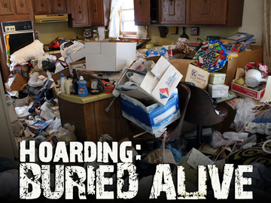
Psychological Disorders
Anxiety disorders
  OCD http://youtu.be/Rn1OYlYzgm8
  PTSD http://youtu.be/ghXCrsTVXtc
Mood disorders
  Depression
  Bipolar
  Suicide prevention
    Self-Reflect ?’s p. 507

